Slide 1


Company Bankruptcy Prediction
Group Leader: 155148842 LIN, Ting-yuan
Group Member: 1155147401 ZHENG, Zhuolin
1155153423 LI, Nai
1155151505 MA, Chunlan

Slide 2


CONTENTS
Context
Data introduction
Data Preprocessing
PCA vs No PCA
Modeling and Evaluation
Hypothesis Testing for Model

Slide 3
01
Context

Slide 4
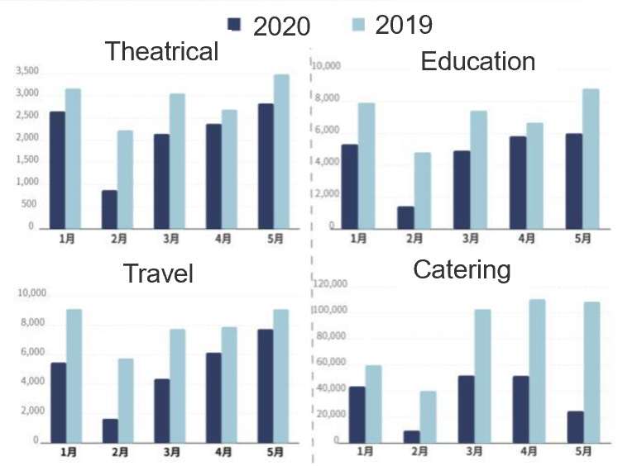
1 Context
Outbreak of COVID-19
The number of bust companies increased sharply.
Comparison of the total number of Mainland bankrupt companies in some industries in 2019 and 2020

Slide 5
1 Context
The need for effective economic early warning system
The awareness of prevention in various companies has been enhanced
In 1932, the first research on companies' financial distress
Introduce Univariate Discriminant Approach (UDA)
Nowadays, machine learning apply into company bankruptcy
Artificial Neural Network
Expert system
Genetic algorithm
……

Slide 6
1 Context
Project Significance
Help companies build effective economic early warning system
Provide decision-making basis for the daily operation of the company
Provide effective predict company bankruptcy tools for investors and analysts

Slide 7
Project pipeline
Data Introduction
Data Set
Feature Selection and Visualization
Feature Selection
Data preprocessing
Oversampling
Visualization
Boxplot
Outlier Removal
Normalization
Radar Chart
PCA vs no PCA
PCA components selection
Modeling and Evaluation
Decision Tree
Hypothesis test for modeling results
Hypothesis testing
Modeling before PCA
Modeling after PCA
Random Forest
KNN
…

Slide 8
02
Data introduction

Slide 9
2.1 Data Set
The data set comes from Kaggle.com (https://www.kaggle.com/fedesoriano/company-bankruptcy-prediction), the original data is from Taiwan Economic Journal for the years 1999 to 2009. The dependent variable bankruptcy is defined based on the business regulations of the Taiwan Stock Exchange. There are 95 features in total in this data set, including ROA, operating gross margin, realized sales gross margin and so on.
6819
6599:
220
The data set consists of 6819 samples, each sample has 95 features and one label
feature
95
float64
The ratio of bankruptcy and non-bankruptcy is 6599:220 (96.77% :3.23% in percentage).
ratio
Most of feature data type is float64.
type

Slide 10

2.2 Feature Selection
The features in data set is too much for model training, we first use variance to drop some useless features. We set the threshold at 5 so that we can delete most features with small variances. We treat data in this way because we think features with small variances do not carry to much information we need to train classification model. After this procedure, there are 21 features left. The top 5 largest variance features are current ratio, fixed assets to assets, net value growth rate, revenue per person and quick asset/current liability.
In order to avoid severe correlation problems, we draw correlation matrix and heatmap to check our 21 features. As heatmap shows, there is no severe correlation problems, so we keep all the 21 features. The 21 features are as follows: Interest-bearing debt interest rate, Revenue Per Share (Yuan ¥), Net Value Growth Rate, Current Ratio, Quick Ratio, Total debt/Total net worth, Long-term fund suitability ratio (A), Accounts Receivable Turnover, Average Collection Days……

Slide 11
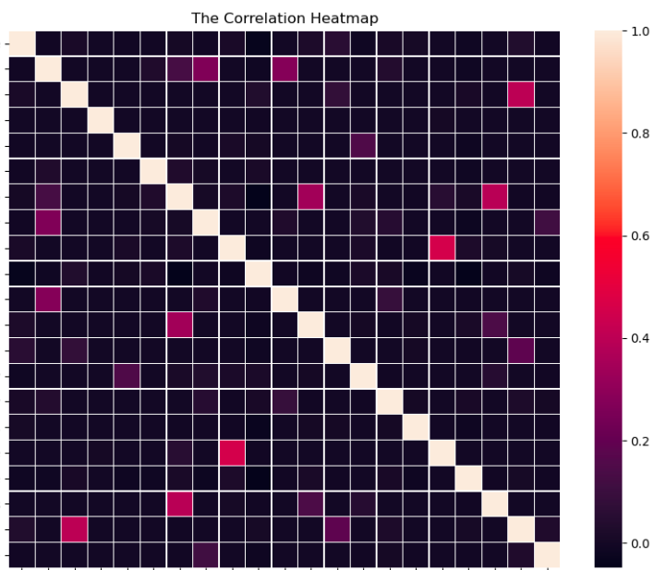
2.3 Heatmap
H
E
A
T
M
A
p

Slide 12
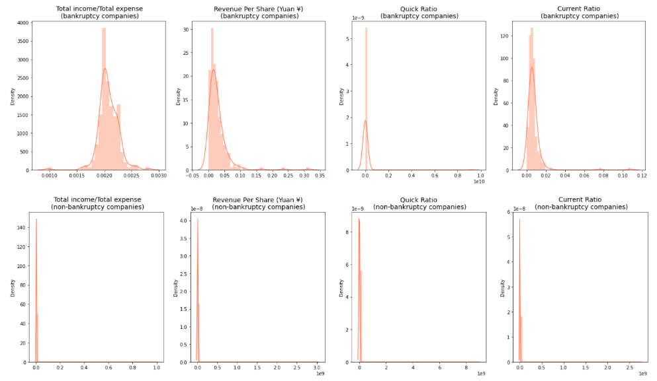
2.4 Visualization
we select four features to further draw distribution plot to show the distribution difference between bankrupt companies and non-bankrupt companies.
The graph shows that the non-bankrupt companies has more centralized data distribution.

Slide 13
03
Data Preprocessing

Slide 14
3.1 Oversampling
3.3 Normalization
3.2 Outlier Removal
3.4 Radar Chart

Slide 15
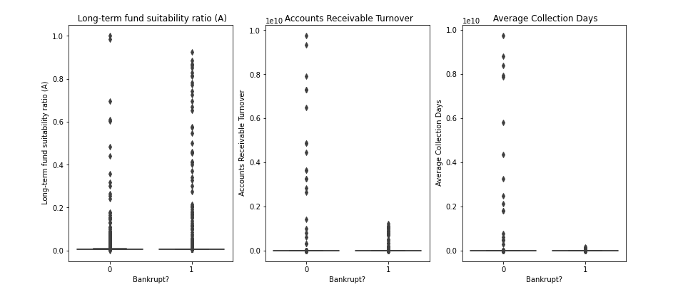
3.1 Oversampling
Since the data ratio of bankruptcy and non-bankruptcy is severely unbalance, we need to do some preprocessing work to balance the data. We try SMOTE to balance our data set. After SMOTE, we have 13198 samples in total and the sample ratio of bankruptcy and non-bankruptcy is 1:1.
3.2 Outlier Removal
In order to avoid the influence of outlier samples, we draw boxplot to detect outlier samples and remove them.
After outlier remove, there are 5655 non-bankruptcy and 5544 bankruptcy samples left.

Slide 16
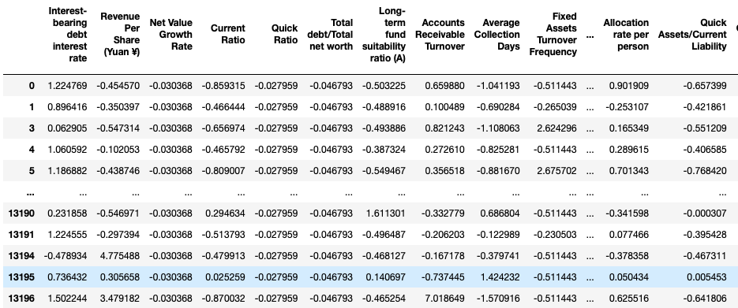
3.3 Normalization
This project includes some distance-based models, so the scaler of features matters a lot, we need to do normalization work to reduce the scaler influence when we train data with distance-based models.

Slide 17
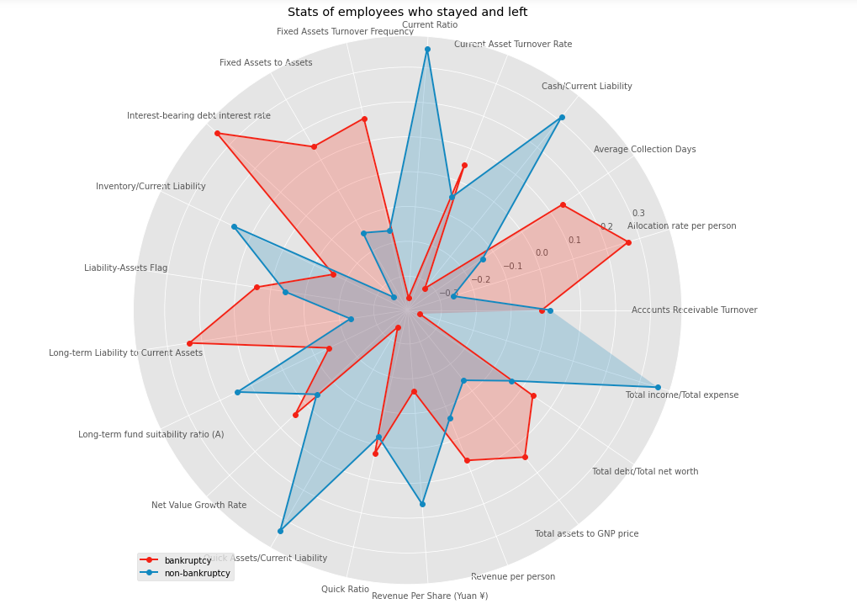
3.4 Radar Chart
The feature mean of bankrupt companies and non-bankruptcy companies is quite different according to radar chart. Current ratio, Cash/Current Liability, Total income/Total expense and Quick Assets/Current Liability are quite different between two class. In non-bankrupt companies, its value is much larger than in bankrupt companies. In the other side, Interest-bearing debt interest rate, Long-term liability to current assets and allocation rate per person, the mean value of bankrupt companies are much higher than non-bankrupt companies.

Slide 18
04
PCA vs No PCA

Slide 19
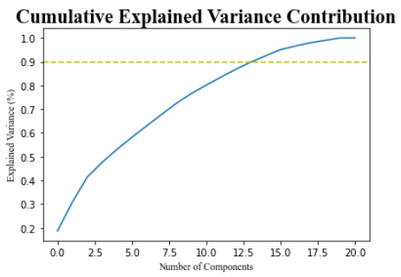
4.1 Determining Components of PCA
Notes:
更多作品请搜索: http://dwz.cn/Wu2UP
19

Slide 20
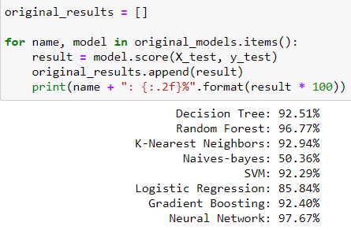
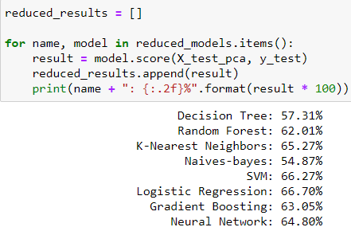
4.2 Model Evaluation Before PCA
4.3 Model Evaluation After PCA
Notes:
更多作品请搜索: http://dwz.cn/Wu2UP
20

Slide 21
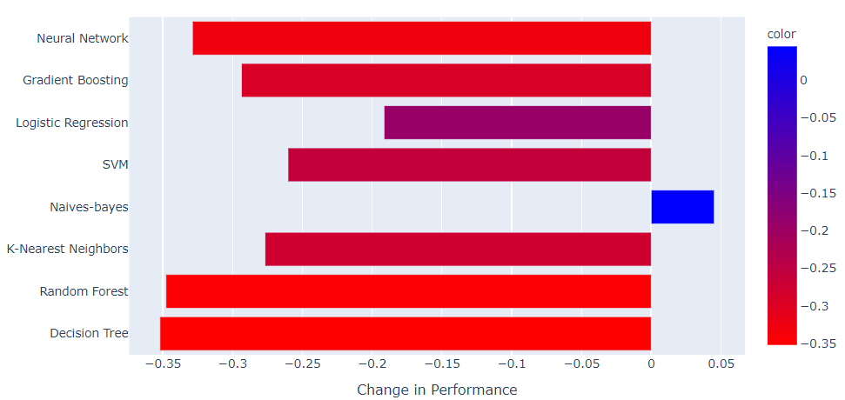
4.4 Change in Model Performance After Dimensionality Reduction
Notes:
更多作品请搜索: http://dwz.cn/Wu2UP
21

Slide 22
05
Modeling and Evaluation

Slide 23
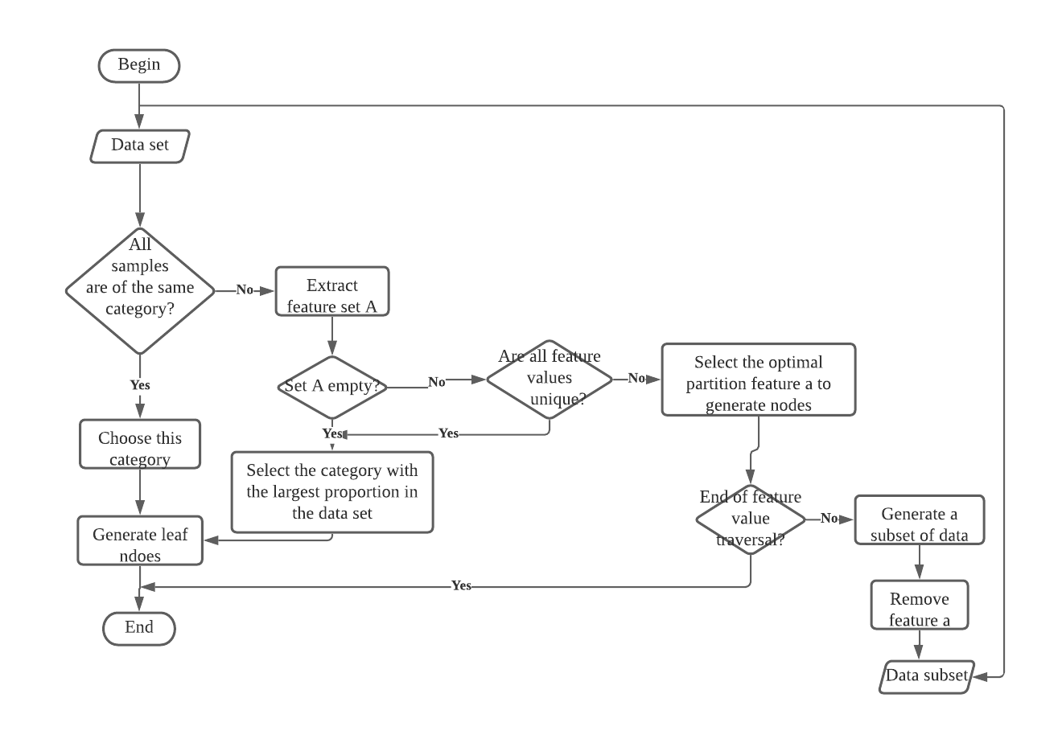
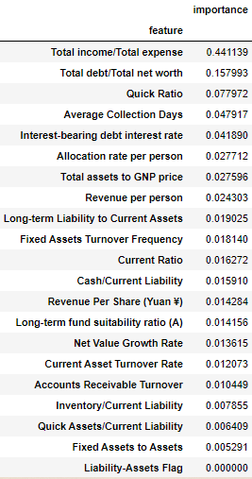
5.1 Decision Tree
a.
b.
The generation process of a decision tree contains three parts: feature selection, decision tree generation, pruning.
Figure (a) shows the pipeline of Decision Tree algorithm.
We use Decision Tree to get the feature importance ranking. Here we select the top 10 features.

Slide 24
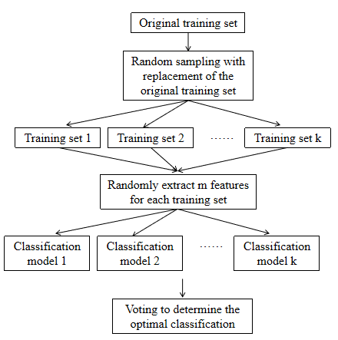
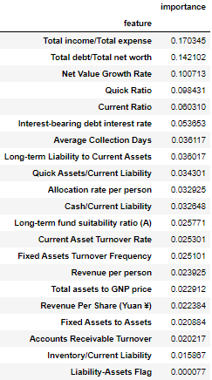
5.2 Random Forest
a.
b.
Random forest is a combination of decision tree and bagging algorithm. It builds a forest in a random manner
Figure (a) shows the pipeline of Random forest algorithm.
We use Random forest to get the feature importance ranking. Here we select the top 10 features.

Slide 25
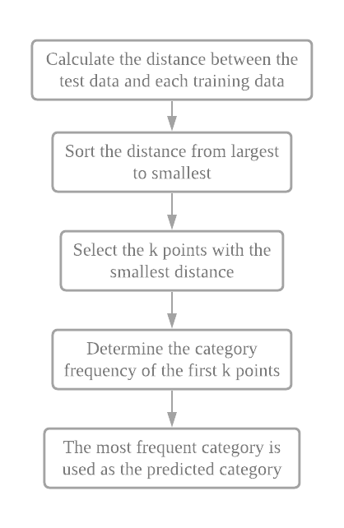
5.3 k-Nearest Neighbors
k-Nearest Neighbors algorithm is a famous statistical method for pattern recognition.
For distance measurement, we commonly use Euclidean distance. For two n-dimensional vectors x and y, the Euclidean distance between the two is defined as:
The left figure shows the pipeline of k-Nearest Neighbors algorithm.

Slide 26
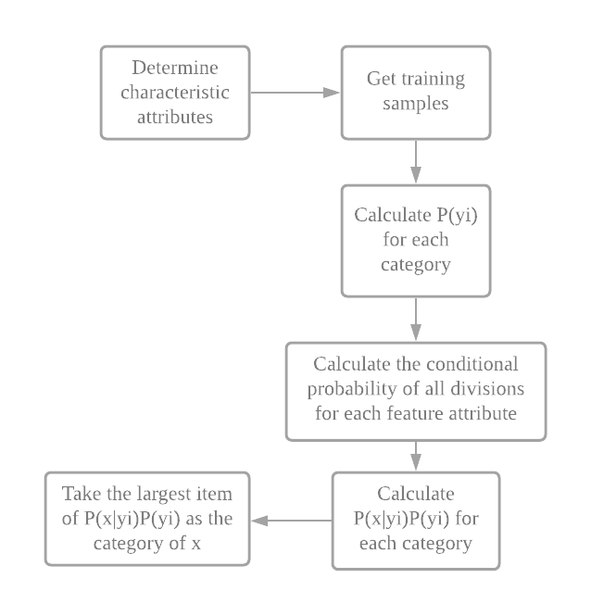


5.4 Naïve Bayes
Naive Bayes Classifier is a generative probabilistic method.
It uses the "attribute conditional independence hypothesis".
Then Bayesian formula is:
Naive Bayesian classification Expression:
The left figure shows the pipeline of Naïve Bayes Neighbors algorithm.

Slide 27
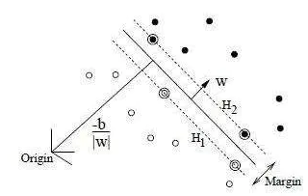
5.5 Support Vector Machine
SVM is to find a hyperplane for given training samples to separate as many positive and negative examples as possible and based positive and negative examples as far as possible from this hyperplane
The points crossed by the dotted line are support vectors(see the figure below)

Slide 28



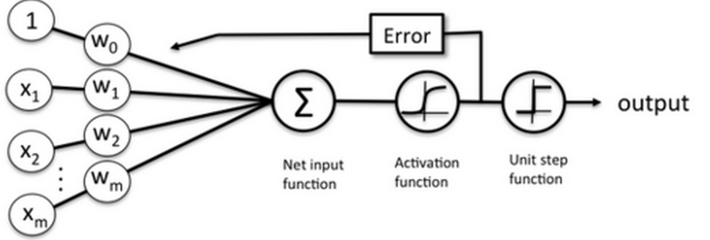
5.6 Logistic Regression
The Sigmoid function
The input of Sigmoid function is defined as z.
Logistic regression model can be written as:
For the figure below, z is net input function and is activation function.

Slide 29
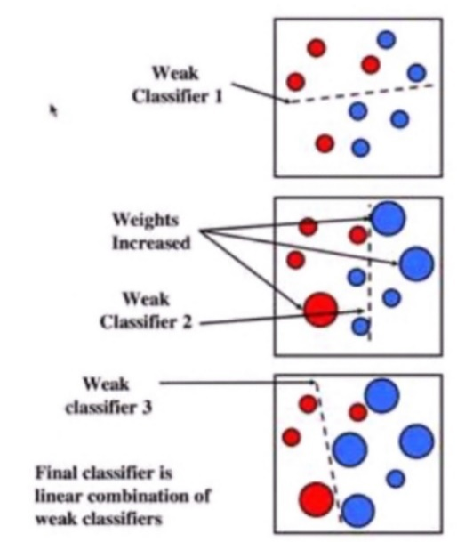
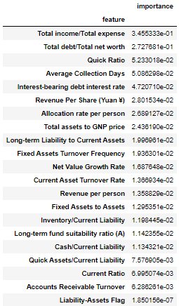
5.7 Gradient Boosting Decision Tree
a.
b.
Gradient Boosting Decision Tree is an iterative decision tree algorithm, which consists of multiple decision trees
The conclusions of all trees are added together to make the final answer.
The boosting is a bias-reduction technique.(see the left figure). Each iteration is based on the results of last iteration.

Slide 30
5.8 Summary
Model | Accuracy Score | Selected Parameters
Decision Tree | 0.9403 | max_depth = 18
Random Forest | 0.9689 | max_depth = 21 n_estimators = 40
k-Nearest Neighbors | 0.9475 | n_neighbors = 2 weights = uniform
Naive Bayes Classifier | 0.5118 | --
Support Vector Machine | 0.9262 | C = 3 tol = 0.06
Logistic Regression | 0.4859 | C = 0.01 tol = 0.0001
Gradient Boosting Decision Tree | 0.9624 | max_depth = 17 min_samples_split = 200
We use Grid SearchCV to get the score and parameters using 5-fold.

Slide 31
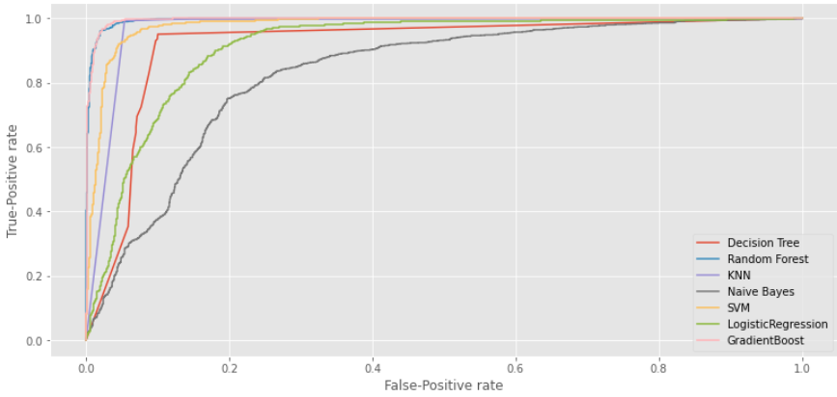
5.9 Receiver Operating Characteristics
ROC curve
Gradient Boosting Decision Tree, Random Forest are the best 2 models.
Notes:
更多作品请搜索: http://dwz.cn/Wu2UP
31

Slide 32
06
Hypothesis Testing of Models

Slide 33
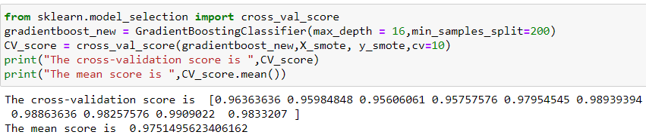
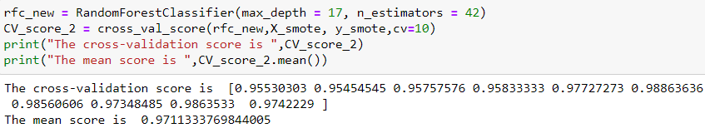
06 Hypothesis Testing for Model Results
6.1 GradientBoostingDecisionTree
6.2 Random Forest
Notes:
更多作品请搜索: http://dwz.cn/Wu2UP
33

Slide 34
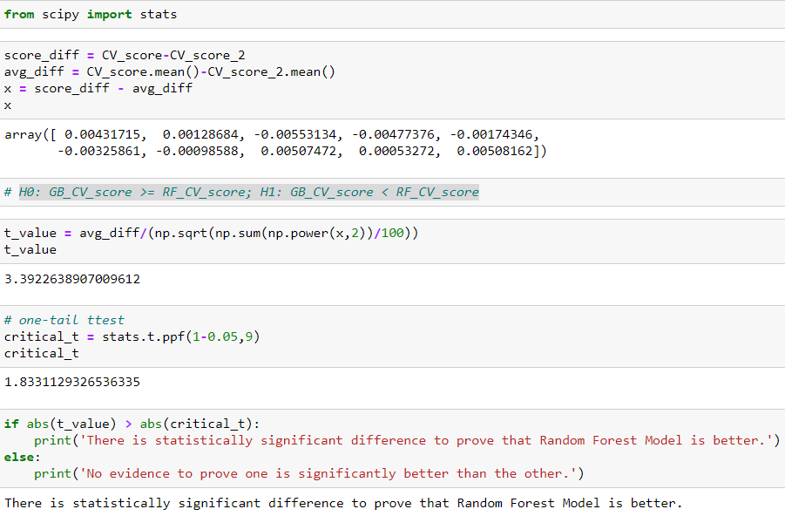
6.3 Hypothesis Test
Null Hypothesis: GB_CV_score >= RF_CV_score
Alternative Hypothesis: GB_CV_score < RF_CV_score
Notes:
更多作品请搜索: http://dwz.cn/Wu2UP
34

Slide 35
07 Conclusion
PCA is not a good approach in predicting bankruptcy, as most of the models except Naïve Bayes decrease in performance
GradientBoostingDecisionTree and Random Forest model perform the best in predicting company bankruptcy
Total income / Total expense, Total debt / Total net worth are the most important ones in fitting Random Forest model among the 95 features
Through this project, we can get further insight about the features, helping companies establish a dynamic indicator monitoring system
Notes:
更多作品请搜索: http://dwz.cn/Wu2UP
35

Slide 36
Thanks for Listening
Presenters:
Date：2021.02
Nai Li
Chunlan Ma
Zhuolin Zheng
Ting-yuan Lin

